Slide 1
Notices: - Get all your data at weather.com! Time automatically sets itself on the blue bar. Also, this PowerPoint was originally made by seminolefanboy on authorstream: http://www.authorstream.com/Presentation/seminolefanboy-1825303-intellistar-v3-emulator/ And other files such as the images were found by Austin M. On twctoday.com! Me, Christian1023 used this and edited it a lot to make it look better. So enjoy! ☺ Also, the time on the bar automatically updates! Which is a neat feature. Everything else must be typed manually.

Slide 2







Weather Bulletin
THE NATIONAL WEATHER SERVICE
Severe Thunderstorm Watch is in effect From 6:00 pm To 12:00 AM CDT.
Now
*
 | --°
*
 | 76°
Local Weather ID: 32504
weather.com
Notes:
‹#›

Slide 3

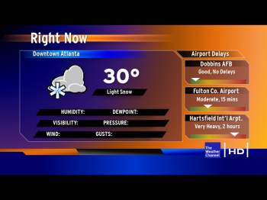


Now
Pensacola
HUMIDITY | 68%
DEW POINT | 36°
PRESSURE | 30.03 MB
VISIBILITY | 10 MILES
WIND | NNW 4 mph
GUSTS | 6 mph
FEELS LIKE | 51°
Sunny
46
Now
*
 | --°
Local Weather ID: 32504
weather.com
Notes:
‹#›

Slide 4
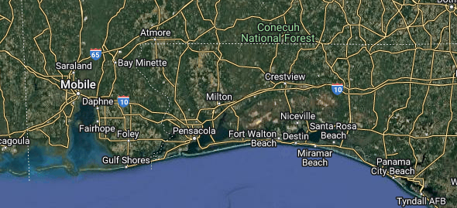

Local Doppler Current State
light
heavy
Now
*
 | --°
Currently : Null, 32504.
weather.com
Notes:
‹#›

Slide 5


Local Forecast
Pensacola
Today
Becoming windy with Thunderstorms Likely. A few storms may be severe. High 51F. Winds NN at 20 to 30 mph. Chance of rain 100%
Now
*
 | --°
Weather Notices: Severe thunderstorms possible this afternoon through tomorrow evening.
weather.com
Notes:
‹#›

Slide 6
Local Forecast
Pensacola
Tonight
Becoming windy with strong thunderstorms, Damaging winds, large hail and possibly a tornado with some storms. winds NNW at 40 to 50 mph. Low 35F. Chance of Rain 100%
Now
*
 | --°
weather.com
Notes:
‹#›

Slide 7
Local Forecast
Pensacola
Tomorrow
Windy with thunderstorms, A few storms may be severe. Winds NNW at 20 to 30 mph. High 56F. Chance of rain 100%
Now
*
 | --°
weather.com
Notes:
‹#›

Slide 8
Local Forecast
Pensacola
Tomorrow night
Windy with thunderstorms, A few storms may be severe. Winds NNW at 30 to 50 mph. Low 40F. Chance of rain 100%
Now
*
 | --°
weather.com
Notes:
‹#›

Slide 9







The Week Ahead
Pensacola
MON | TUE | WED | THU | FRI | SAT | SUN
Thunder storms | Rain to Ice | Rain/Snow | Snow | Heavy Snow | Light Rain | Fog
56 | 45 | 27 | 19 | 17 | 28 | 40
40 | 22 | 13 | 12 | 14 | 22 | 32
Now
*
 | --°
weather.com
Notes:
‹#›

Slide 10
5/23/13

